Slide 1
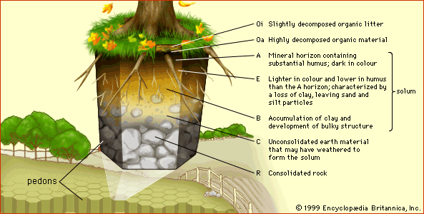
Educational
.
How you communicate without words?
What can we learn from trees?
What did the trees conversation teach you about teams?
How can we reinforce the forests and help them deal with climate change and by the same token, what can this teach up about making our communities stronger?
Can communities self heal?
Trees is just the theme for the words that you generate around the ideas
Trees
What is the story of the person next to you? Share something small.
Trees often help each other
Trees are not just competitors, but cooperators
Hub trees nurture their young
Forests are complex systems with hubs and networks
Trees are super cooperators
What is a mother tree?
What does she mean by tipping point?
What tools do you need to make the communities around you stronger?
.
…
Christopher Bauman – www.chrisbauman.com.au

Slide 2
1. Can tree talk to each other ____________________________________________________________________________________________?
Advanced Question Words
2. What can we learn from trees ___________________________________________________________________________________________ ?
A stand
Tree crowns
Mineral horizons
white mycelium
3. Trees share information below ground… What can people share? ___________________________________________________________________________________________ ?
Pallet of roots and soil
4 Sometimes things don’t go to plan… Can you think of a small example (Learning?) ___________________________________________________________________________________________ ?
Clearcutting
Isolated
5. Why is it important to communicate with others who are different to us? ___________________________________________________________________________________________ ?
More commercially valuable
Altruistic act
6. What does she mean by being interdependent ___________________________________________________________________________________________ ?
outhouse
Persevere
Elbow room
7. Seedlings thrive when nurtured by mother trees (what can we learn from this?) ___________________________________________________________________________________________ ?
The tip of the iceberg
kin
8. Conversations increase the resilience of the whole community ____________________________________________________________________________________________ ?
pristine
Pass on wisdom
ecosystem
What are the advantages of biodiversity – in a forest and in society?
Solutions / learning: get local involvement – grow knowledge of local community, save old growth forests (knowledge/ genes/ networks), Save the legacy to pass on to the next generation, Welcome and seek out diversity
.

